Slide 1
COURSE CONNECTOR
NAMES:
MAAN PATEL
HEMIL PATEL
HARSH VASOYA
DARSH PARIKH
DVIJ PARIKH

Slide 2
Introduction
Purpose: CourseConnector aims to provide personalized resources tailored to individual courses and professors to improve student learning outcomes.
Features:
Access to study materials and resources.
Collaborative study groups to foster peer learning.
Peer tutoring services to provide personalized assistance.
Type: A mobile application designed for both iOS and Android platforms, with future web integration planned.

Slide 3
Survey Process
Objective: Conducted surveys to understand student challenges and preferences.
Methodology:
Conducted surveys among university students.
Key questions focused on academic difficulties, preferred study methods, and opinions on peer tutoring and study resources.
Insights:
A strong demand for personalized resources.
Interest in features like peer tutoring and collaborative tools.
Outcome: These insights helped shape the app’s core features and design.

Slide 4
Use-Case / Class Diagrams

Slide 5
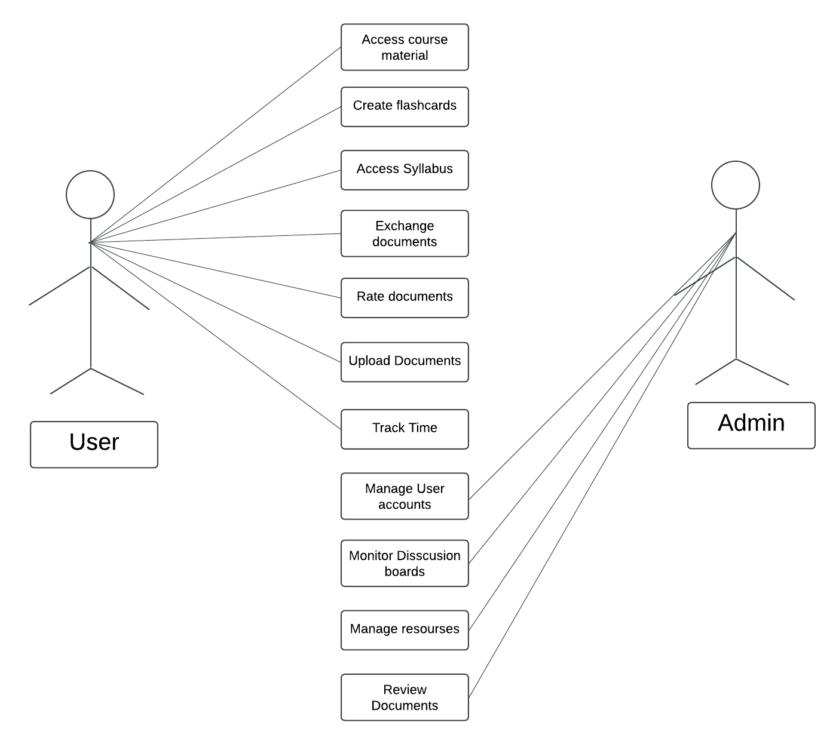
Use-Case Diagram
Purpose: This diagram represents the interactions between different actors (Student, Tutor, and Admin) and the CourseConnector system.
Actors:
Student: Uploads and accesses course materials, creates/joins study groups, and books tutoring sessions.
Tutor: Sets availability, manages tutoring sessions, and processes payments.
Admin: Manages system resources, and user accounts, and oversees discussion boards.
Key Use Cases:
Upload Documents: Students can upload study materials for sharing.
Access Resources: Students access personalized resources based on their enrolled courses.
Manage Sessions: Tutors handle booking, scheduling, and conducting tutoring sessions.
Monitor System: Admin oversees system functionality and manages user issues.

Slide 6
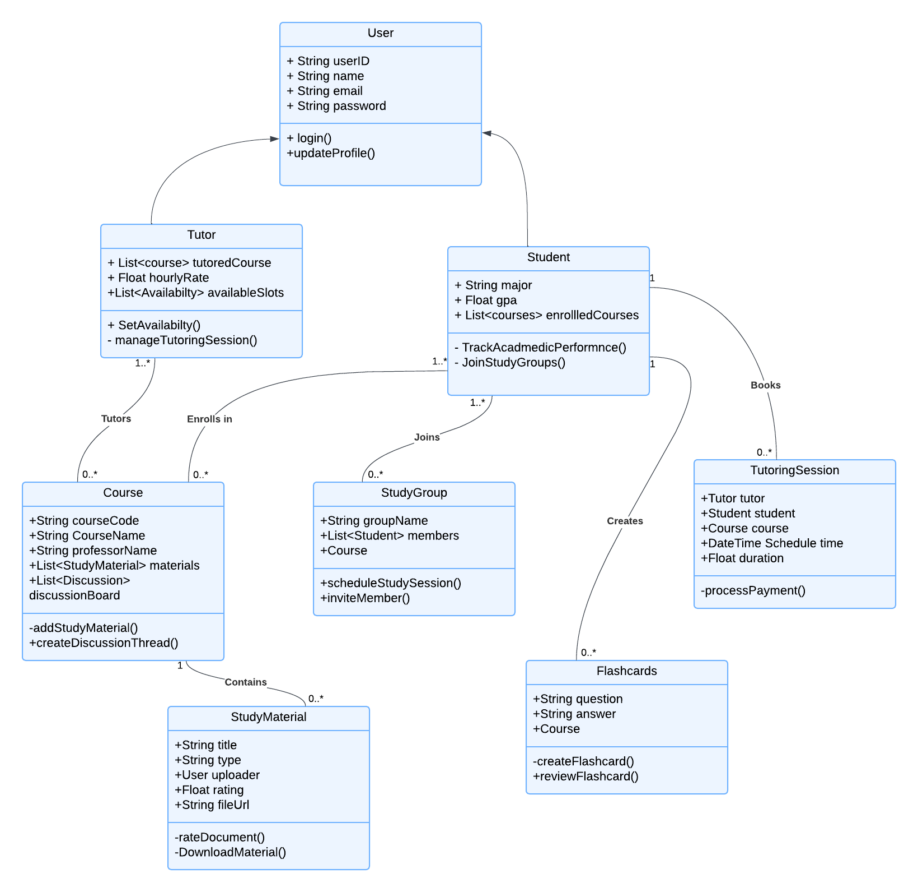
Class Diagram
Purpose: Defines the static structure of the system, focusing on classes, their attributes, methods, and relationships.
Key Classes:
User: A parent class with attributes like userID, email, and methods like login() and updateProfile().
Student: Inherits from User; includes attributes like major, GPA, and methods for tracking academic performance and joining study groups.
Tutor: Inherits from User; manages availability, hourly rate, and tutoring sessions.
Course: Represents courses, with associated study materials, discussions, and professors.
StudyGroup: Facilitates collaboration among students enrolled in a course.
Study Material: Represents uploaded materials with features for rating and downloading.
Tutoring Session: Handles session booking, schedule time, and payment processing.
Relationships:
One-to-many: A student can enroll in multiple courses.
One-to-one: Each tutoring session is between one tutor and one student.
Many-to-many: Students join multiple study groups, and groups can include many students.

Slide 7
Data Flow Diagrams

Slide 8
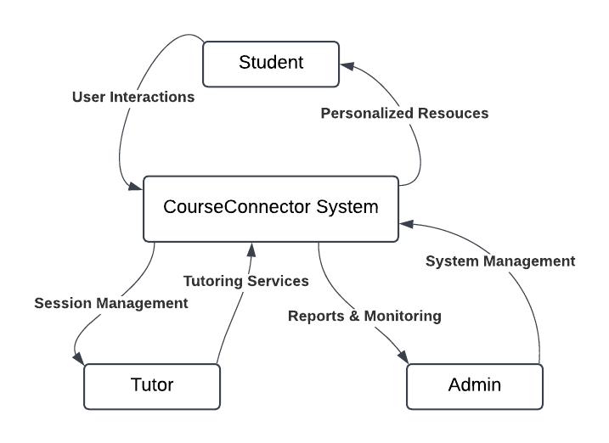
Data Flow Diagram (Level 0)
Purpose: Provides a high-level overview of the system’s data flow.
Process:
Students interact with the CourseConnector system to access study materials, join study groups, and book tutoring sessions.
Tutors manage their availability and conduct tutoring sessions.
Admin monitors activities and maintains system integrity.
Key Flows:
Data flows from students (e.g., uploaded study materials) to the system for validation and storage.
Tutors interact with the system for session bookings.
Admin performs backend monitoring tasks.

Slide 9
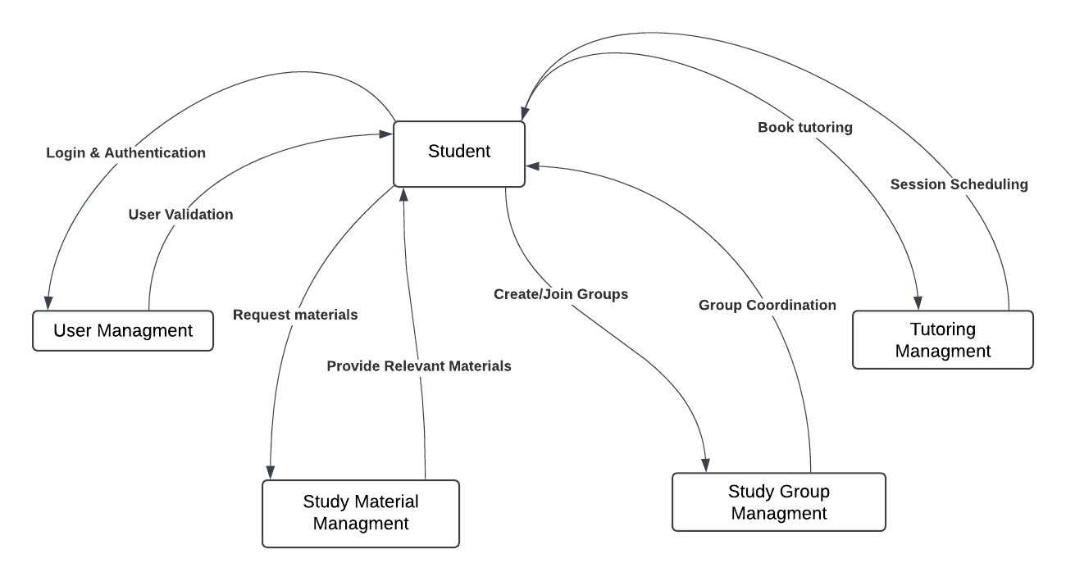
Data Flow Diagram (Level 1)
Purpose: Break down the processes in Level 0 into more detailed components.
Processes:
User Management: Handles login, registration, and user profile updates.
Study Material Management: Uploading, validating, and retrieving study materials.
Tutoring Management: Scheduling, payment processing, and session confirmations.
Key Flows:
A student uploads a document, which is validated and stored in the system.
Tutoring sessions involve checking tutor availability, confirming the session, and processing payments.

Slide 10
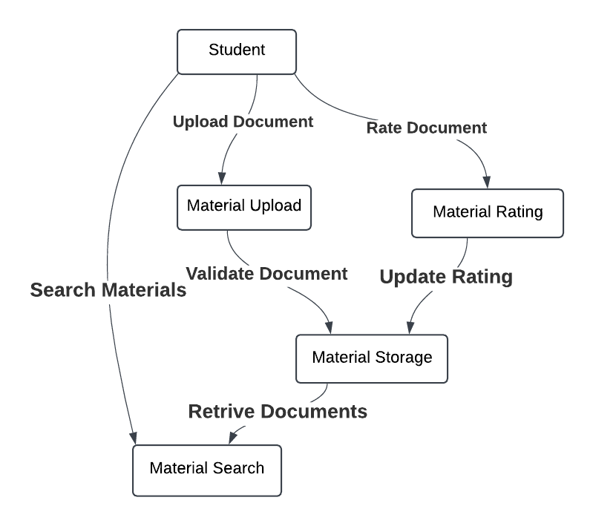
Data Flow Diagram (Level 2 - Study Material Management)
Purpose: Focuses on the detailed flow for managing study materials.
Steps:
A student selects a file to upload.
The system validates the file.
If valid, the file is stored, and metadata is saved.
Students can search and retrieve materials for their enrolled courses.
Key Components:
Material Upload UI: Interface for file upload.
File Validation: Ensures the file meets system standards.
StorageService: Stores the file and its metadata securely.
Database: Saves file metadata for future retrieval.

Slide 11
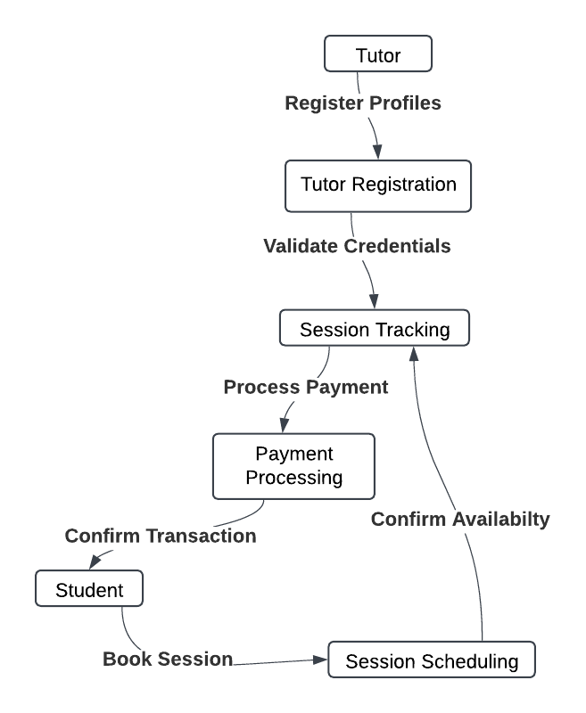
Data Flow Diagram (Level 2 - Tutoring Management)
Purpose: Focuses on managing tutoring session bookings.
Steps:
A student requests a session.
The system checks the tutor’s availability.
The tutor confirms or rejects the session.
If confirmed, payment is processed, and the session is scheduled.
Key Components:
Tutoring Management System: Handles session scheduling.
Payment System: Processes payments and confirms transactions.
Tutor: Confirms availability and conducts sessions.

Slide 12
Sequence Diagrams

Slide 13
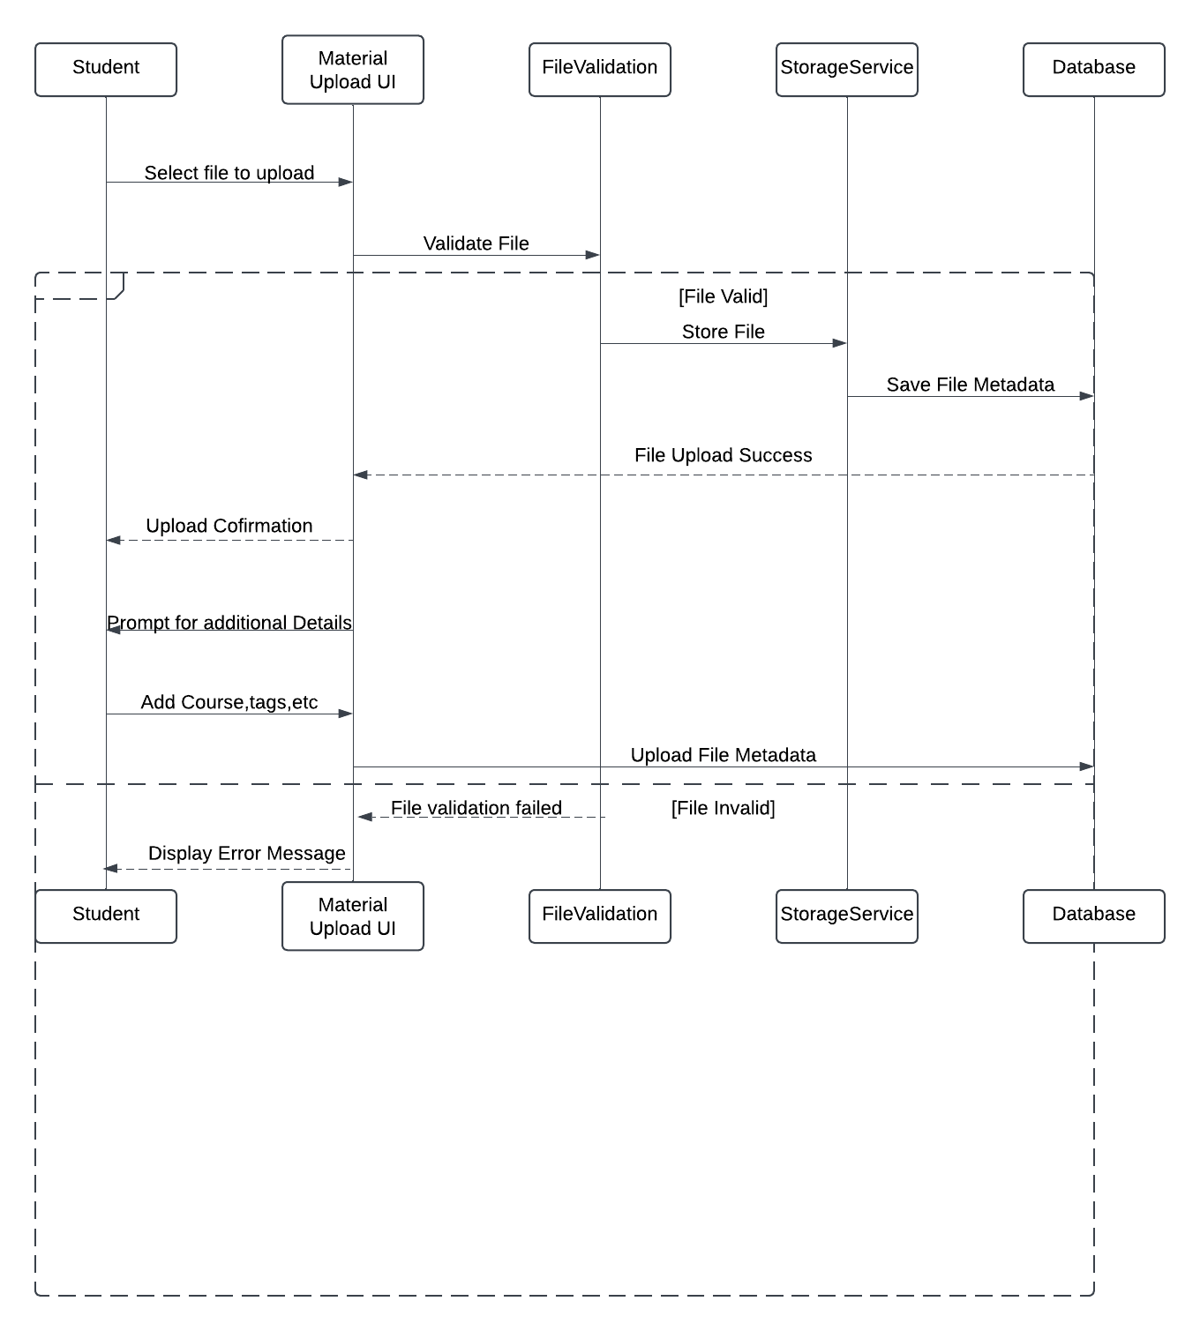
Sequence Diagram - Study Material Upload
Purpose: Describes the step-by-step process for uploading study materials.
Flow:
The student selects a file and initiates the upload.
The system validates the file format and contents.
If valid, the file is stored in the database.
Metadata (e.g., title, tags) is saved for searchability.
Confirmation is sent to the student.
Key Actors:
Student, Material Upload UI, FileValidation, StorageService, Database.

Slide 14
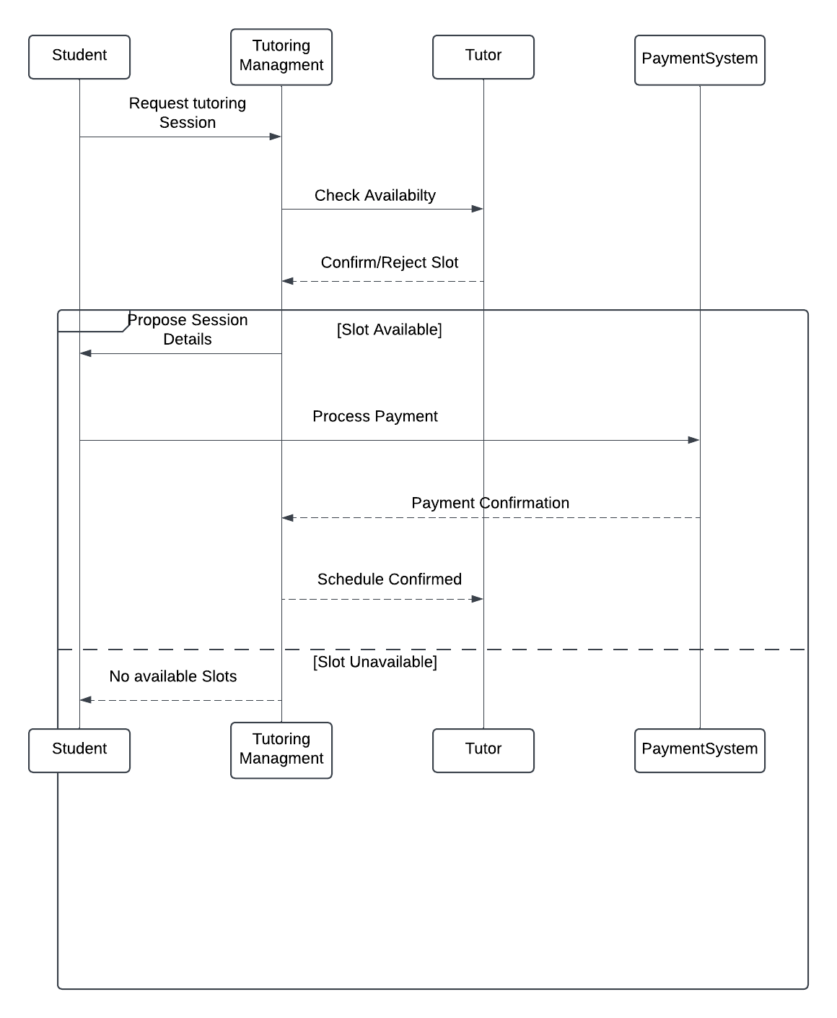
Sequence Diagram - Tutoring Session
Purpose: Shows the process of booking and conducting tutoring sessions.
Flow:
The student requests a session.
The tutoring management system checks tutor availability.
The tutor confirms the session.
The payment system processes the payment.
Both student and tutor receive confirmation, and the session is scheduled.
Key Actors:
Student, Tutoring Management, Tutor, Payment System.

Slide 15
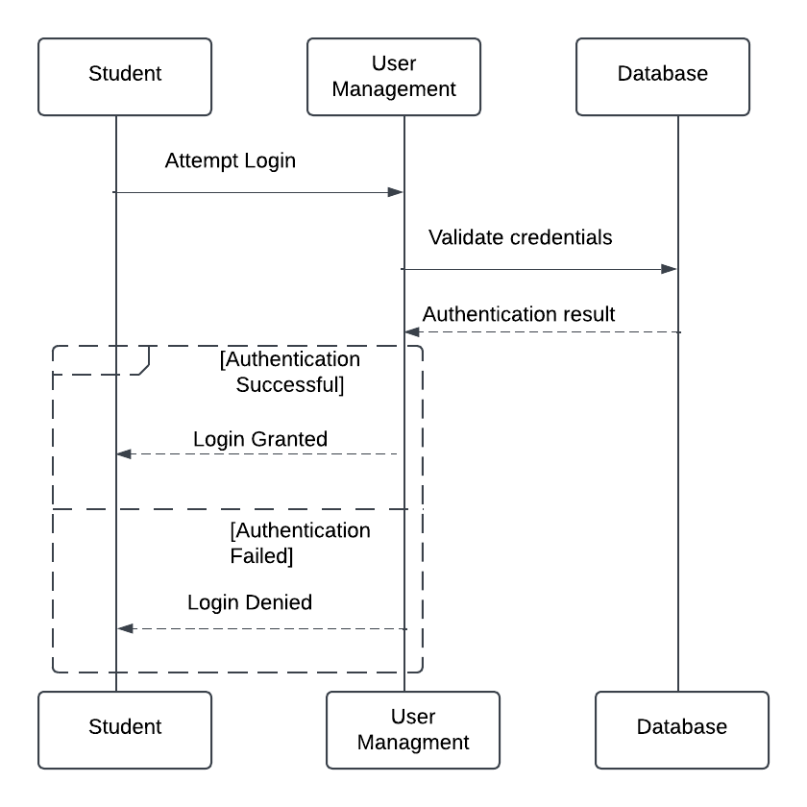
Sequence Diagram - User Authentication
Purpose: Explains the login process and credential validation.
Flow:
A student attempts to log in by entering credentials.
The system validates the credentials by querying the database.
If credentials match, access is granted; otherwise, the login is denied with an error message.
Key Actors:
Student, User Management System, Database.

Slide 16
Experiences and Challenges

Slide 17
Experiences and Challenges
Team Collaboration:
Used GitHub for version control and Slack for communication.
Tasks were distributed based on individual expertise.
Challenges:
Integrating multiple APIs for dynamic functionalities.
Ensuring consistency across data flow diagrams.
Balancing UI/UX design with backend functionality.
Lessons Learned:
Importance of clear requirements and iterative development.
The value of teamwork and effective communication.

Slide 18
Conclusion
Summary:
Course-Connector addresses student challenges by offering personalized resources.
The system integrates features like study groups, tutoring, and material sharing.
Future Plans:
Expand to web platforms.
Add additional features like mental health resources and advanced academic tools.

Slide 19
QUESTIONS

